Slide 1
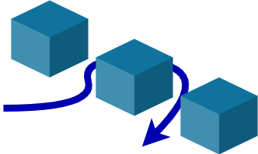

RRT Algorithm
Rapidly Exploring Random Tree
We are Team 2
Track 4: Robotic Motion Planning. How to move?
Notes:
Hi everyone, I am Raymond, and I am going to present on Task 3 of Track 4, Rapidly Exploring Random Tree Algorithm.
My presentation is based on the lecture video from Northwestern Robotics.

Slide 2
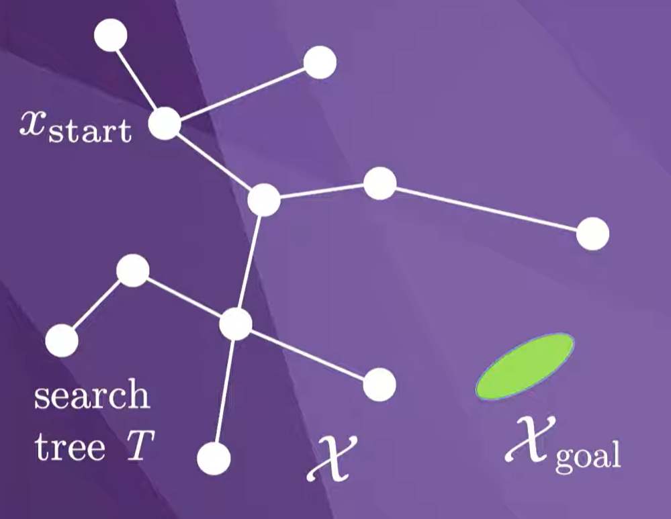
The Mission
Navigate from X_start to X_goal.
Every so often the sample X_sample should be chosen inside of X_goal to try to complete the planning problem.
Image taken from
https://www.youtube.com/watch?v=Ao7p_xiUu4s
2
Notes:
Assume X is our problem space.
Our mission is to navigate from X_start to X_goal.

Slide 3
The Mission
Navigate from X_start to X_goal.
Every so often the sample X_sample should be chosen inside of X_goal to try to complete the planning problem.
Image taken from
https://www.youtube.com/watch?v=Ao7p_xiUu4s
2
Notes:
The algorithm randomly samples a point in the problem space and grow the search tree.

Slide 4
The Mission
Navigate from X_start to X_goal.
Every so often the sample X_sample should be chosen inside of X_goal to try to complete the planning problem.
Image taken from
https://www.youtube.com/watch?v=Ao7p_xiUu4s
2
Notes:
The algorithm randomly samples a point in the problem space and grow the search tree.

Slide 5
The Mission
Navigate from X_start to X_goal.
Every so often the sample X_sample should be chosen inside of X_goal to try to complete the planning problem.
Image taken from
https://www.youtube.com/watch?v=Ao7p_xiUu4s
2
Notes:
The algorithm randomly samples a point in the problem space and grow the search tree.

Slide 6
The Mission
Navigate from X_start to X_goal.
Every so often the sample X_sample should be chosen inside of X_goal to try to complete the planning problem.
Image taken from
https://www.youtube.com/watch?v=Ao7p_xiUu4s
2
Notes:
Every so often the sample X_sample should be chosen inside of X_goal to try to complete the planning problem.

Slide 7
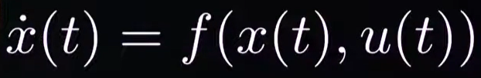
Rapidly Exploring Random Tree (RRT) Algorithm
The RRT is a sampling-based motion planner that applies to robots with arbitrary dynamics of the form:
Where,
x(t) : State vector at time t
Ẋ(t) : Tme derivative of the state.
u(t) : Control input at time t.
f(⋅) : System dynamics function
3
Notes:
The RRT is a sampling-based motion planner that applies to robots with arbitrary dynamics of the form x dot t equals f of xt and ut.
This arbitrary dynamics equation describes system dynamics: the rate of change of the state x depends on the current state and control input. In simple terms, how something moves depends on where it is and what action you apply to it.
If we dissect the equation, x(t) is the state vector at time t which describes the system’s condition. In the context of a robot, this could be the position & velocity.
x˙(t) is the time derivative of te state. It represents how the state changes over time. If x is position, then x’ is velocity. It tells us the dynamics.
U(t) is the control input, where it could be accelerate, turn left, turn right.

Slide 8
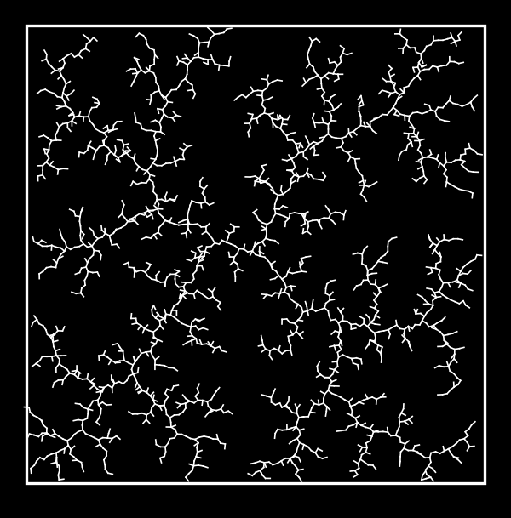
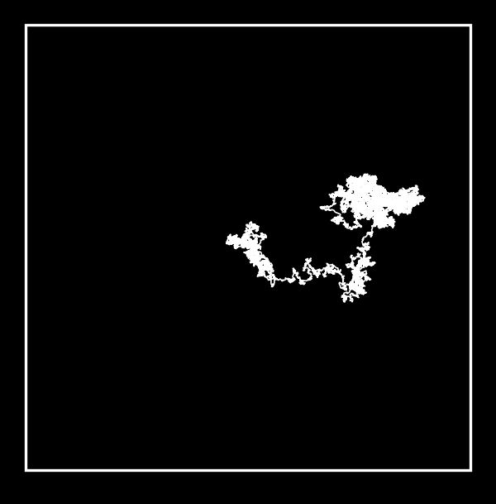
Comparison between RRT and Random Walk
RRT
Random Walk
4
Notes:
And why RRT instead of randomly choosing a point around to obtain the solution path?
With RRT, samples are chosen uniformly randomly from the space, and the motion planer from the nearest node goes directly towards the sampled node, up to a maximum step size. The randomly chosen samples “pull” the tree to explore the state space.
Compare this to a random walk, where at each step the tree is grown from a randomly chosen node by the maximum step size in a randomly chosen direction, After the same number of nodes, the random walk has not explored very much of the state space.

Slide 9
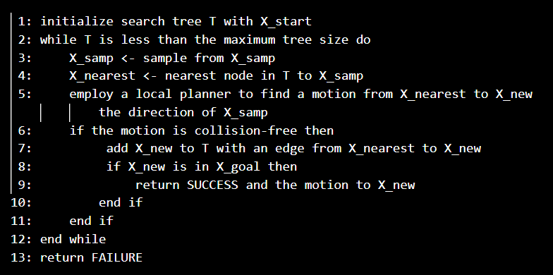
Pseudocode of RRT Algorithm (1/2)
5
Notes:
This is the pseudocode of the RRT Algorithm.
In line 3, we sample from the state space.

Slide 10
Pseudocode of RRT Algorithm (1/2)
6
Notes:
In line 4, we find the nearest node already in the tree.

Slide 11
Pseudocode of RRT Algorithm (1/2)
7
Notes:
In line 5, we use a local planner to find a motion from this nearest node to a state closer to the sampled state.

Slide 12
Pseudocode of RRT Algorithm (1/2)
8
Notes:
In lines 6 and 7, a new edge is added to the tree if the motion from line 5 is collision free.

Slide 13
Pseudocode of RRT Algorithm (1/2)
9
Notes:
Finally, in lines 8 and 9, we check to see if the new node is in the goal region, and if so, the planner has succeeded.
The plan is reconstructed by following the sequence of parent nodes backward from the node in the goal region.

Slide 14
Pseudocode of RRT Algorithm
10
Notes:
Let’s focus on line 4. Line 4 chooses the node in the tree that is closest to the new sample.
For example, if the configuration consists of linear and angular coordinates, how do we compare a distance of one radian to a distance of one meter?

Slide 15
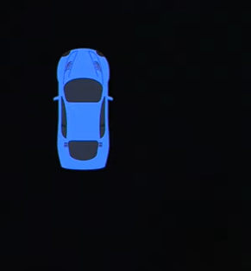
Which white car configuration is closest to blue?
Image taken from
https://www.youtube.com/watch?v=Ao7p_xiUu4s
11
Notes:
As an example, this blue car represents a sampled configuration of a car and these white cars represent configurations of nodes already in the tree.
Which of these configurations is closest to the sample?
I would say that this configuration is probably the closest, since a path to the sample probably takes less time than paths from the other configurations, considering the car’s motion constraints.

Slide 16
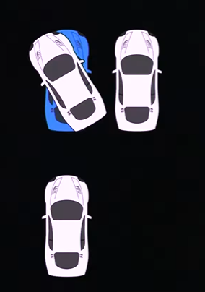
Which white car configuration is closest to blue?
Image taken from
https://www.youtube.com/watch?v=Ao7p_xiUu4s
11
Notes:
As another example, this blue car represents a sampled configuration of a car and these white cars represent configurations of nodes already in the tree.
Which of these configurations is closest to the sample?
I would say that this configuration is probably the closest, since a path to the sample probably takes less time than paths from the other configurations, considering the car’s motion constraints.

Slide 17
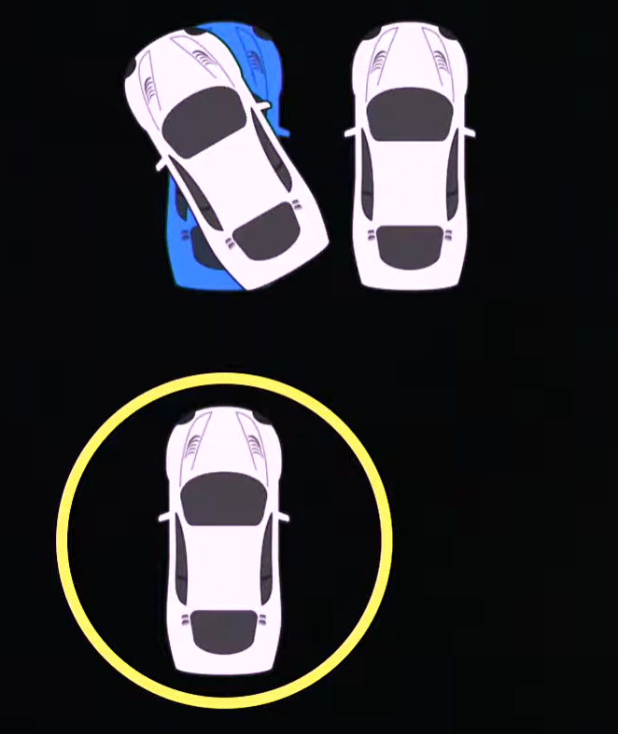
Which white car configuration is closest to blue?
3
2
1
Image taken from
https://www.youtube.com/watch?v=Ao7p_xiUu4s
11
Notes:
As another example, this blue car represents a sampled configuration of a car and these white cars represent configurations of nodes already in the tree.
Which of these configurations is closest to the sample?
I would say that this configuration is probably the closest, since a path to the sample probably takes less time than paths from the other configurations, considering the car’s motion constraints.

Slide 18
Pseudocode of RRT Algorithm
12
Notes:
And hence line 5 is the local planner that plans on how to move the robot to the new point.

Slide 19
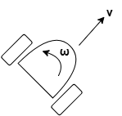
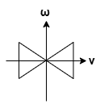

Simple Local Planner: How to move?
Straight-line path for kinematic, fully actuated robots
Integrated discretized control that gets “closest” to the sampled state
13
Notes:
For example, a car-like robot has 2 controls:
The linear velocity v and the angular velocity omega.
For a car with a bounded linear speed and a bounded turning radius, the bounds on the controls look like this bowtie.
We can discretize this control set as 6 velocities, including forward motion, backward motion, and turns at the tightest turning radius. The integrals of these controls are shown here.

Slide 20
Examples of Local Planners
Straight-line path for kinematic, fully actuated robots
Integrated discretized control that gets “closest” to the sampled state
Forward
13
Notes:
For example, a car-like robot has 2 controls:
The linear velocity v and the angular velocity omega.
For a car with a bounded linear speed and a bounded turning radius, the bounds on the controls look like this bowtie.
We can discretize this control set as 6 velocities, including forward motion, backward motion, and turns at the tightest turning radius. The integrals of these controls are shown here.

Slide 21
Examples of Local Planners
Straight-line path for kinematic, fully actuated robots
Integrated discretized control that gets “closest” to the sampled state
Backward
13
Notes:
For example, a car-like robot has 2 controls:
The linear velocity v and the angular velocity omega.
For a car with a bounded linear speed and a bounded turning radius, the bounds on the controls look like this bowtie.
We can discretize this control set as 6 velocities, including forward motion, backward motion, and turns at the tightest turning radius. The integrals of these controls are shown here.

Slide 22
Examples of Local Planners
Straight-line path for kinematic, fully actuated robots
Integrated discretized control that gets “closest” to the sampled state
Forward Left
13
Notes:
For example, a car-like robot has 2 controls:
The linear velocity v and the angular velocity omega.
For a car with a bounded linear speed and a bounded turning radius, the bounds on the controls look like this bowtie.
We can discretize this control set as 6 velocities, including forward motion, backward motion, and turns at the tightest turning radius. The integrals of these controls are shown here.

Slide 23
Examples of Local Planners
Straight-line path for kinematic, fully actuated robots
Integrated discretized control that gets “closest” to the sampled state
Backward Right
13
Notes:
For example, a car-like robot has 2 controls:
The linear velocity v and the angular velocity omega.
For a car with a bounded linear speed and a bounded turning radius, the bounds on the controls look like this bowtie.
We can discretize this control set as 6 velocities, including forward motion, backward motion, and turns at the tightest turning radius. The integrals of these controls are shown here.

Slide 24
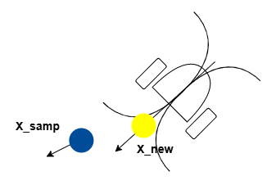
Examples of Local Planners
Straight-line path for kinematic, fully actuated robots
Integrated discretized control that gets “closest” to the sampled state
14
Notes:
If the sampled state is here, then the closest integrated state is shown here.
If this path is collision free, then x_new will be added to the RRT.

Slide 25
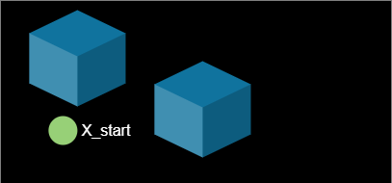
Recap: Step 1: Roll The Dice (Sampling)
X_rand RANDOM_STATE()
15
Notes:
So to simply recap the flow of RRT Algorithm, first we roll the dice and sample a potential solution in the problem space.

Slide 26
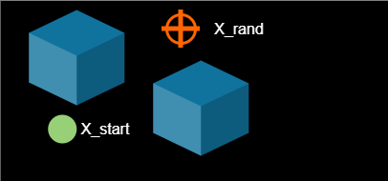
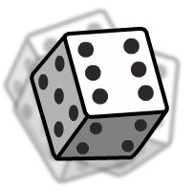
Recap: Step 1: Roll The Dice (Sampling)
X_rand RANDOM_STATE()
15
Notes:
It could be here

Slide 27
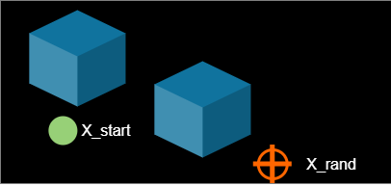
Recap: Step 1: Roll The Dice (Sampling)
X_rand RANDOM_STATE()
15
Notes:
here

Slide 28
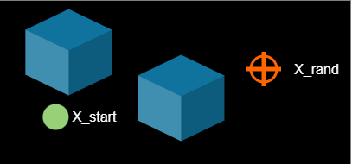
Recap: Step 1: Roll The Dice (Sampling)
X_rand RANDOM_STATE()
Pick a spot. Anywhere.
15
Notes:
Or here.

Slide 29
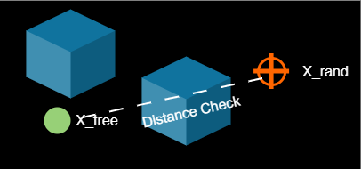
Recap: Step 2: Find the Closest Buddy
X_near NEAREST_NEIGHBOR(X_rand, Tree)
15
Notes:
Next, we check if the selected node is closest to the current tree node, if so then we will add it to the tree.

Slide 30
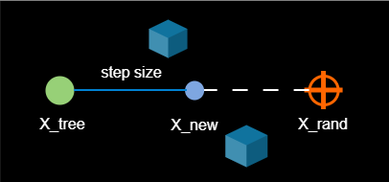
Recap: Step 3: Don’t Jump, Just Step
X_new STEER(X_near, X_rand, step_size)
Move fixed distance
toward target.
16
Notes:
And then we will move towards the random point with our selected step size.

Slide 31
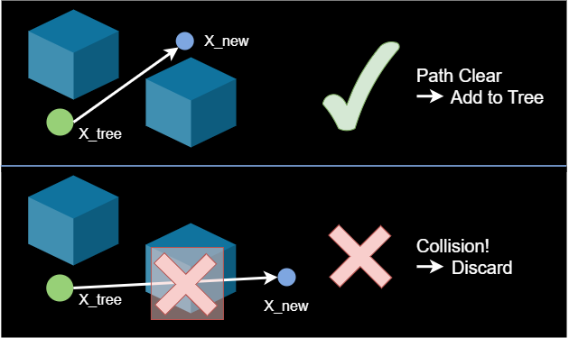
Recap: Step 4: Watch Your Head
If COLLISION_FREE(X_tree, X_new) then ADD
17
Notes:
After which we will check if there is any collision.
If no, then we will add it to the tree. Otherwise we will discard it.

Slide 32
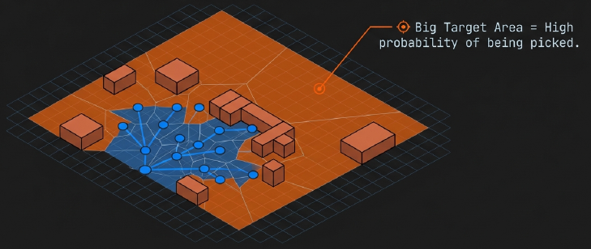
Why It Works: The Voronoi Bias
Large empty spaces = Large target probability
18
Notes:
And why does the algorithm works?
Voronoi bias is a property in rapidly-exploring random trees (RRT) where, during search, the probability of selecting a node for expansion is proportional to the volume of its Voronoi region.
That is, the bigger the target area, the higher the probability of having a tree solution.

Slide 33
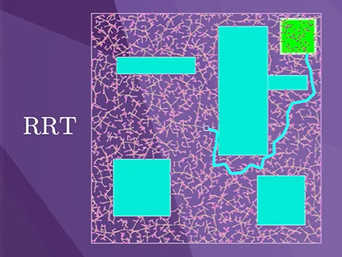
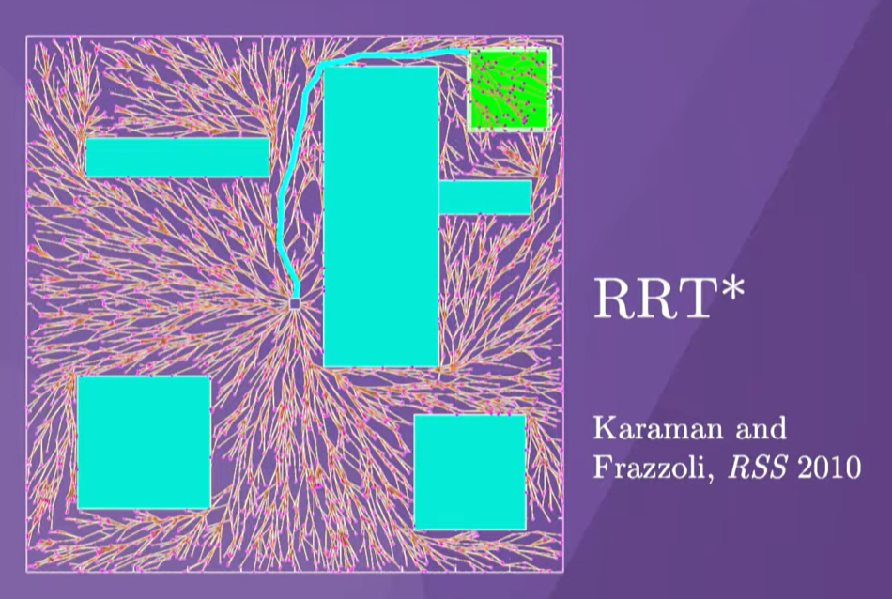
Improvement: RRT*
Image taken from
https://www.youtube.com/watch?v=Ao7p_xiUu4s
19
Notes:
If we wanted to improve the quality of the solution, we could continue to grow the RRT after an initial solution is found, and keep the best solution, as we see in this figure.
The path indicated is the best path found so far to the green goal region after generating 5000 nodes in the tree.
This process does not result in solutions that tend to an optimal solution.
However, a modification to the basic algorithm, called RRT-star, continually rewires the search tree so that the solution tends to the optimal solution as the number of nodes in the tree goes to infinity.

Slide 34
A Live Visualization of the RRT Algorithm
20
Notes:
And here’s a live visualization of the RRT Algorithm trying to reach the circle success region, with a small rectangle obstacle in between.

Slide 35
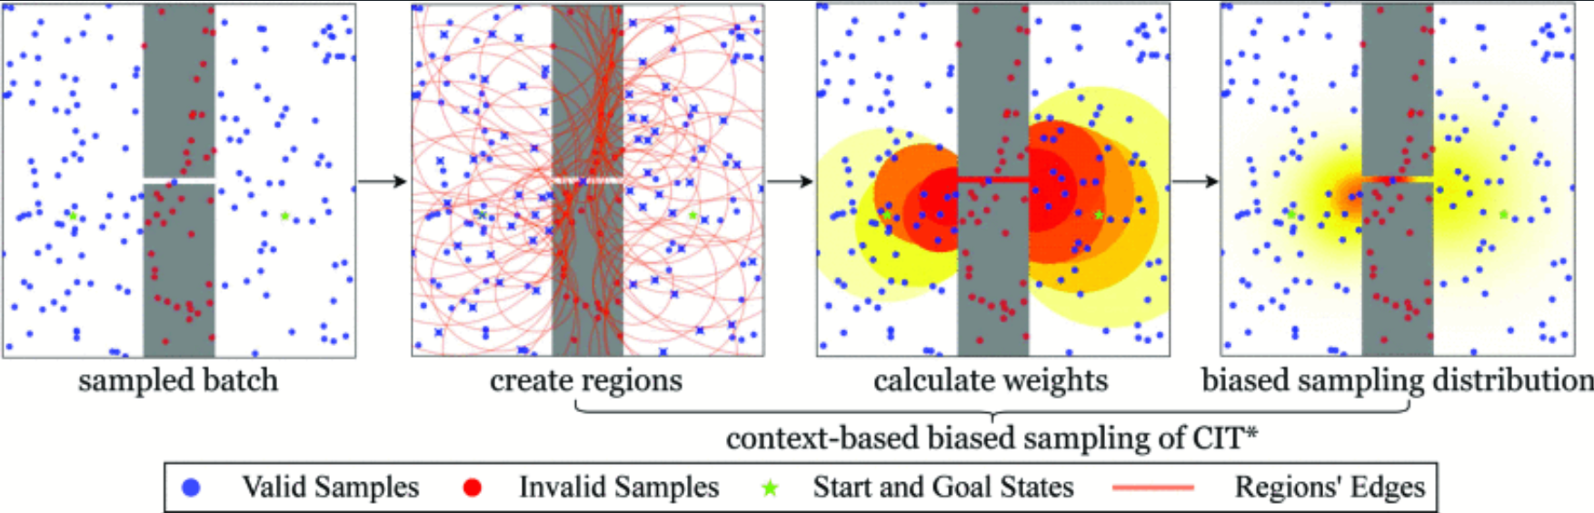
Possible Issue and Solution
Problem: Hard to fit into narrow passage
Solution: Utilizing context-based biased batch sampling
L. Zhang et al., "CIT*: Context-Based Biased Batch-Sampling for Almost-Surely Asymptotically Optimal Motion Planning," 2025 IEEE/RSJ International Conference on Intelligent Robots and Systems (IROS), Hangzhou, China, 2025, pp. 4421-4428, doi: 10.1109/IROS60139.2025.11246858.
21
Notes:
When sampling the problem space, it is possible to sample elsewhere and it will waste a lot of computation cycles of the node sampling. It takes more iterations for the RRT to sample within the narrow passage.
CIT* addresses the limitations of uniform sampling in narrow passages by utilizing context-based biased batch sampling to focus exploration on critical, unexplored areas. The algorithm employs kernel density estimation (KDE) to calculate uncertainty for specific regions, naturally assigning higher sampling weights to constrained spaces like narrow gaps where valid samples are scarce. To further refine this process, connection-greedy prioritization (CGP) directs these samples toward regions that facilitate connectivity between the start and goal trees, ensuring efficient path discovery in highly restricted environments

Slide 36
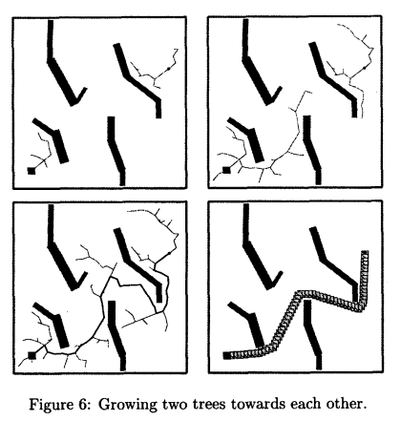
Possible Improvements
Use RRT Connect to grow trees from both ends (start and goal)
J. J. Kuffner and S. M. LaValle, "RRT-connect: An efficient approach to single-query path planning," Proceedings 2000 ICRA. Millennium Conference. IEEE International Conference on Robotics and Automation. Symposia Proceedings (Cat. No.00CH37065), San Francisco, CA, USA, 2000, pp. 995-1001 vol.2, doi: 10.1109/ROBOT.2000.844730.
21

Slide 37
Curious Question
Is there any specific hardware to accelerate the calculation of kinematics and robotic related algorithms?
My assumption is using Vector Processing Unit to accelerate Vector heavy calculations such as IK/FK/Jacobian.
How about motor controls at the joints?
Does the industry use off-the-shelf microcontrollers or are there application-specific designs?
21
Notes:
I’m from chip design background so I am curious what is the hardware bottlenecks in the robotics application domain

